Slide 1
CAR Calibration Meeting CAR Review
AP Team
Funny Li, Tony Hsu and Ronald Tse
September 2013

Slide 2
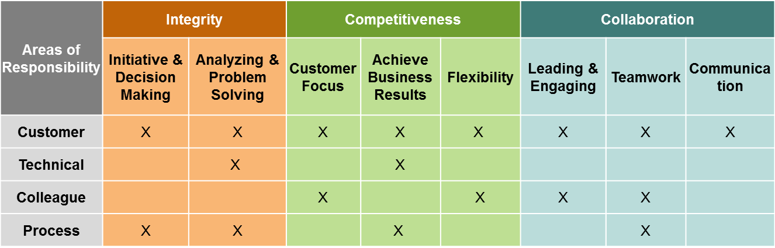
CAR Champion Critical Behaviors for Success
Alignment with Critical Behaviors for Success and UL Values
CAR Champion, Areas of Responsibility:
C – Customer; T – Technical; L – Colleague; P – Process.
Notes:
EIGHT (8) CBS attributes :-
(CAR Champion, Areas of Responsibility: C – Customer; T – Technical; L – Colleague; P – Process)

Slide 3
Study for CAR# 123911678

Slide 4
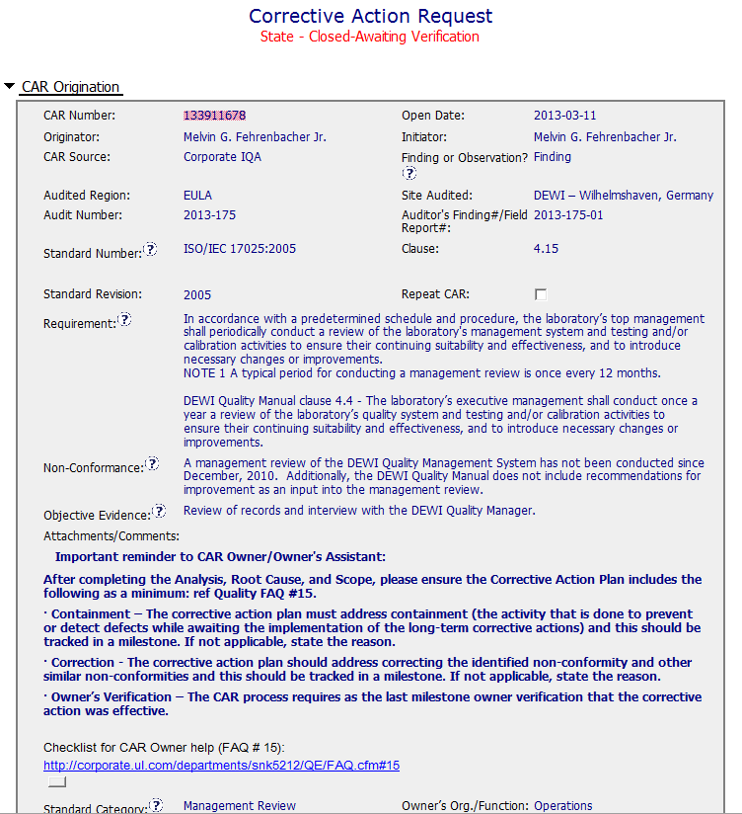
CAR# 133911678
There are TWO (2) discrepancies: a) Failure conducting Management Review in the required time period, and b) Missing input element in the Management Review process. There should be two separate root cause analysis.
Moderate Instruction Provided
Notes:
For the CAR# 133911678:
[CAR Review based on 00-QA-S0006 - Corrective Action Request Process]
In the session of “Non-Conformance”, there are TWO (2) discrepancies:
Failure conducting Management Review in the required time period, and
Missing input element in the Management Review process. There should be two separate root cause analysis.

Slide 5
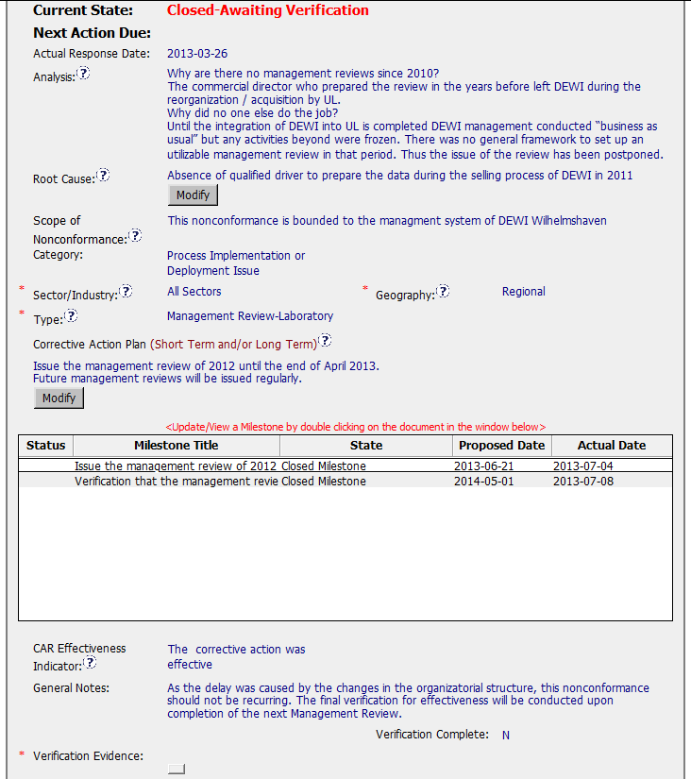
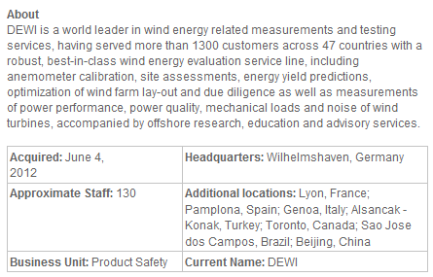
CAR# 133911678 (Analysis)
The “5 WHYs” approach hasn’t been utilized well because it doesn’t seem that it is able to identify the possible causes.
And there is no analysis related to illustrate why “Recommendation for improvement” is not covered as input in the process of Management Review stated in the current DEWI Quality Manual.
DEWI is merged on 2012-06-04, how about year 2011?
No linkage from Analysis to Root Cause “qualified driver”??
[Collaboration] (C L) – To be improved by engaging with CAR Owner to get deeper analysis.
[Competitiveness] (C) – To be improved by engaging with CAR Owner to get a clear path of analysis.
[Integrity] (P) – To be improved of determination by declining the insufficient analysis results.
Notes:
Analysis – clear path to root cause; stakeholders identified
There are TWO (2) discrepancies: a) Failure conducting Management Review in the required time period, and b) Missing input element in the Management Review process. There should be two separate root cause analysis.
The “5 WHYs” approach hasn’t been utilized well because it doesn’t seem that it is able to identify the possible causes. For example, as mentioned in the “Analysis” field that “There was no general framework to set up an utilizable management review in that period. Thus the issue of the review has been postponed….” It is questionable whether it is specifically illustrated in the DEWI Quality Manual about the process and framework of Management Review, or the process is not even existing, or other reasons resulting now Management Review is not executed in the required timeframe after a personnel left the organization? The “5 WHYs” analysis can go further deeper.
In addition, does a statement “… Thus the issue of the review has been postponed.” mean that does the previous Management Review officially determine to be postponed? If yes, is there any supporting evidence?
And there is no analysis related to illustrate why “Recommendation for improvement” is not covered as input in the process of Management Review stated in the current DEWI Quality Manual.

Slide 6
CAR# 133911678 (Root Cause & Scope)
Not quite sure whether how would the process and initiator of the Management Review be outlined in the Quality Manual or the related SOPs. For the instance, is there a deputy person being determined to keep running of the Management Review process for any reason the initiator is absence.
Another root cause is not addressed and identified.
The widespread of the discrepancy has not been addressed in this field. e.g. How would it be affected by division, operation team, function, area/region, and the time period?
[Collaboration] (C L) – To be improved by engaging with CAR Owner to get succinct and reasonable root cause statement.
[Competitiveness] (C) – To be improved by engaging with CAR Owner to get succinct and reasonable root cause statement.
[Integrity] (P) – To be improved of determination by declining the incomplete root cause.
Notes:
Root Cause – is succinct; reasonable and complete based upon the analysis
Not quite sure whether how would the process and initiator of the Management Review be outlined in the Quality Manual or the related SOPs. For the instance, is there a deputy person being determined to keep running of the Management Review process for any reason the initiator is absence.
Absence of the initiator in this case is not necessary resulting the failure of the quality process. [Refer to back to the result of the root cause analysis]
As mentioned above, there should be two separate root cause analysis. Another root cause is not addressed and identified.
Scope – tells how widespread the problem is
The widespread of the discrepancy has not been addressed in this field. e.g. How would it be affected by division, operation team, function, area/region, and the time period?
Remarks: Prior to the CAR review, if I were the CAR Administrator, it is necessary to clarify what are the differences to the organizations of DEWI and DEWI Wilhelmshaven, are they different entities? And is there any operation connection to DEWI-OCC?

Slide 7
CAR# 133911678 (Category, Sector/Industry, Type & Geography)
Satisfaction
Satisfaction
Not clearly illustrated in the field of “Analysis” to support it to be identified as “Regional”.
Satisfaction
[Collaboration] (C L) – To be improved by engaging with CAR Owner to clarify the rationale of geography selection.
[Integrity] (T) – Good. Appropriate “Category”, “Sector/Industry” and “type” are selected.
Notes:
Category
→ Satisfaction
Sector/Industry
→ Satisfaction
Type
→ Satisfaction
Geography – apparent from the analysis
Not clearly illustrated in the field of “Analysis” to support it to be “Regional”.

Slide 8
CAR# 133911678 (Corrective Action)
If it only addresses the Containment to the “Root Cause” recorded above, it is sufficient…
However, the reason of why failure conducting of previous Management Review is not addressed in the fields of “Root Cause” and “Correction Action Plan”.
The corrective action managing the root cause has not been addressed.
Again, there is no any corrective action related to address why “Recommendation for improvement” is not covered as input in the process of Management Review stated in the current DEWI Quality Manual.
[Collaboration] (C L) – To be improved by working with CAR Owner to get the reasonable CA Plan that is able to fix the root cause.
[Competitiveness] (C) – To be improved by engaging with CAR Owner to fix the objective evidence and other problems found.
[Integrity] (P) – To be improved of determination by declining the insufficient CA Plan.
Notes:
Corrective Actions – fix the objective evidence
If it only addresses the Containment to the “Root Cause” recorded above, I think it is sufficient…
However, the reason of why failure conducting of previous Management Review is not addressed in the fields of “Root Cause” and “Correction Action Plan”.
Corrective Actions – address the entire root cause
As noted above, it is sufficient to cover the containment action though, the corrective action managing the root cause has not been addressed.
Again, there is no any corrective action related to address why “Recommendation for improvement” is not covered as input in the process of Management Review stated in the current DEWI Quality Manual.
Corrective Actions – address the items identified in the analysis
As noted above.
Corrective Actions – cover the scope and geography
Comment as stated in “Geography” above.

Slide 9
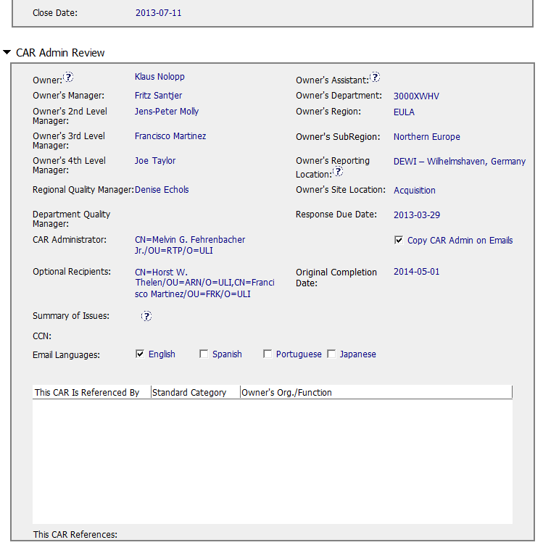
CAR# 133911678 (CAR Admin Review)
Good and No Abnormality
[Collaboration] (C L) – Good. CAR Owner, CAR Escalation Path and Optional Recipients are set appropriately.
Notes:
Good and no abnormality is found.

Slide 10
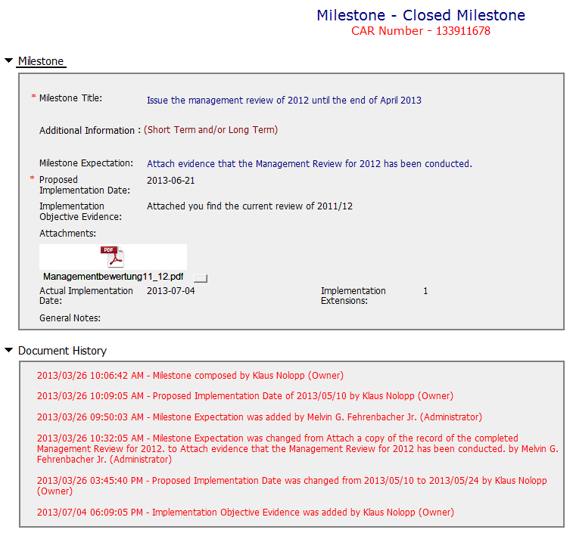
CAR# 133911678 (Milestones)
Milestone solely for containment is good (i.e. Management Review Report for Year 2011 and Year 2012).
[Suggest to inviting a person could read German for verification whether “Recommendation for improvement” is now covered as input in the process of Management Review.]
[Collaboration] (L, C L) – Good. Containment and its supporting evidence are reviewed appropriately.
Notes:
Milestones – address containment unless CAP indicates reason why not required
Milestone solely for containment is good but not for corrective action. [Suggest to inviting a person could read German for verification whether “Recommendation for improvement” is now covered as input in the process of Management Review.]
See below comments for corrective actions.

Slide 11
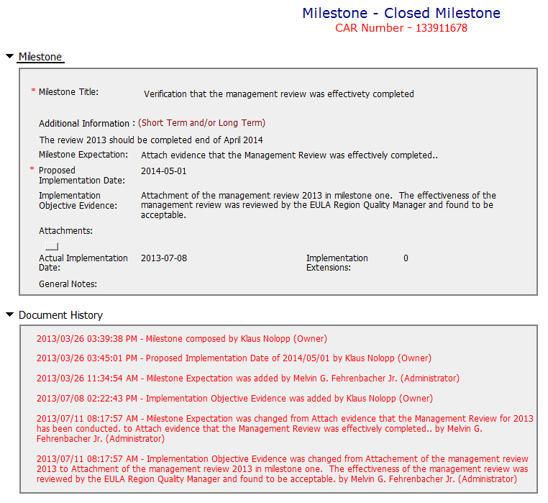
CAR# 133911678 (Milestones)
Although CAR owner self-verification is added at the last milestone, it doesn’t cover the corrective action for the failure conducting previous Management Review.
In fact, would the next round of Management Review be able to conducted on-time, it has not been addressed.
In addition, it is suggested that a statement should be provided by CAR Owner to indicate that “Recommendation for improvement” is now covered as input in the process of Management Review for Year 2011 and 2012 if it is really covered...
The evidence “Attachment of the management review 2013 in milestone one. The effectiveness of the management review was reviewed by the EULA Region Quality Manager (how, and evidence?) and found to be acceptable.” stated in the 2nd milestone is irrelevant while the Management Review for Year 2013 has not been conducted yet.
[Collaboration] (L, C L) – To be improved by working with CAR Owner to determine suitable milestones and set up their expectation.
[Competitiveness] (P) – To be improved by engaging with CAR Owner to complete milestone as per expectation.
[Integrity] (P) – To be improved of determination by declining the insufficient milestone.
Notes:
Milestones – have final milestone for owner’s verification of effectiveness; enough time is allowed for new records to be examined
Although CAR owner self-verification is added at the last milestone, it doesn’t cover the corrective action for the failure conducting previous Management Review.
In fact, would the next round of Management Review be able to conducted on-time, it has not been addressed.
It is suggested that the verification should focus on whether the updated process and/or next round of Management Review is in place to avoid recurrence of such nonconformity.
Milestones – completed per milestone expectations
It is acceptable as Containment Action for the supporting evidence covered in the 1st milestone, i.e. Management Review Report for Year 2011 and Year 2012 [Suggest to inviting a person could read German for verification…].
However, the evidence “Attachment of the management review 2013 in milestone one. The effectiveness of the management review was reviewed by the EULA Region Quality Manager and found to be acceptable.” stated in the 2nd milestone is irrelevant while the Management Review for Year 2013 has not been conducted yet. Not sure how CAR Administrator accepts it.
In addition, for 2nd milestone, it is suggested that a statement should be provided by CAR Owner to indicate that “Recommendation for improvement” is now covered as input in the process of Management Review for Year 2011 and 2012...

Slide 12
CAR# 133911678 (Verification)
Please be noted that this CAR hasn’t been closed yet. It is still under a state of “Closed Awaiting Verification”, hence, the field of “Verification Evidence” is still kept empty.
However, when both root cause identification and the related corrective action stated in 2nd milestone are questionable, the comment “The corrective action was effective” stated in the field of “CAR Effectiveness Indicator” shows too generic and lack of logical consideration… Not auditable.
[Collaboration] (C L) – To be improved by proactively working with CAR Owner to verify the effectiveness of the agreed CA Plan in the agreed time slots.
[Integrity] (P, T) – To be improved by providing reasonable and sufficient verification indicator.
Notes:
Verification – completed within 6 months of CAR closure or explanation provided; enough time is allowed for new records to be examined
Please be noted that this CAR hasn’t been closed yet. It is still under a state of “Closed Awaiting Verification”, hence, the field of “Verification Evidence” is still kept empty.
However, when both root cause identification and the related corrective action stated in 2nd milestone are questionable, the comment “The corrective action was effective” stated in the field of “CAR Effectiveness Indicator” shows too generic and lack of logical consideration…
If I were the CAR Administrator, will suggest the CAR Owner to reconsider the revisit of the current Management Review process and hence fill up the loophole resulting this nonconformance by adding one or two more milestones to illustrate and support the proper completion of corresponding efforts / activities. The timeline of last milestone for CAR Owner self-verification could be set right after completion of Management Review for Year 2013.
For the “General Notes”, shouldn’t it be an analysis field provided by CAR Owner instead of CAR Admin?

Slide 13
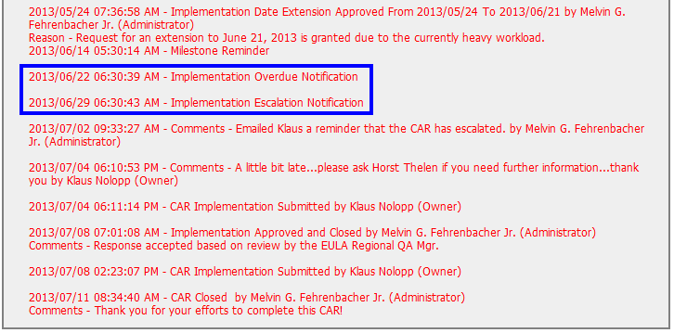
CAR# 133911678 (Extension)
The number of extensions is still meeting the requirement.
Other than this, suggest sending e-mail in advance to remind CAR Owner separately to avoid CAR overdue and/or escalation. Put the communication with CAR Owner into the CAR DB as evidence.
[Collaboration] (C L) – Good. Sending separated e-mail reminder to alert CAR Owner that the CAR has been escalation due to implementation overdue.
[Integrity] (C, T) – Good. No extension is over 30 days or more than 3 times.
Notes:
Extensions – within requirements (<30 days, 3 or less)
The number of extensions is still meeting the requirement.
Other than this, suggest sending e-mail in advance to remind CAR Owner separately to avoid CAR overdue and/or escalation. Put the communication with CAR Owner into the CAR DB as evidence.

Slide 14

CAR Review
Sept 27, 2013
Mark Lavine, Mel Fehrenbacher

Slide 15
CAR 133911678
Well written finding, clear, referenced requirement.
Analysis is thin
Second milestone should have had “Response accepted based on review by the EULA Regional QA Mgr”
Isolated instance? If so what evidence to demonstrate this? Additional samples.
Is there opportunity to prevent recurrence even though this is unusual situation?
Competitiveness requires speed, change. It challenges us to maintain integrity in a competitive environment

